Slide 1
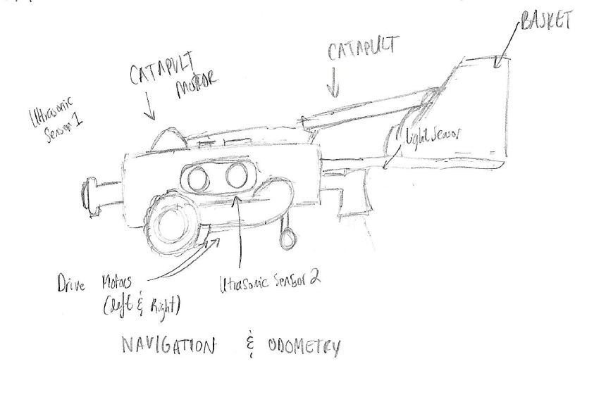
NXT-BRICK SKETCH MODEL Author: Eric Vuong
Version: 1.0
Brick Used: 1
Components:
3 Motor
2 Ultrasonic Sensors
1 Light Sensor

Slide 2
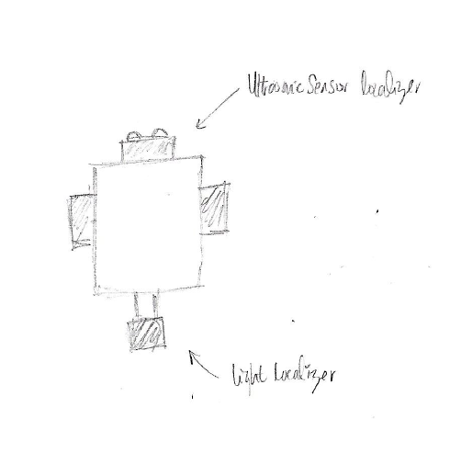
Localization Mode
Light Sensor → Used for localization
Front Ultrasonic Sensor → Used for localization

Slide 3
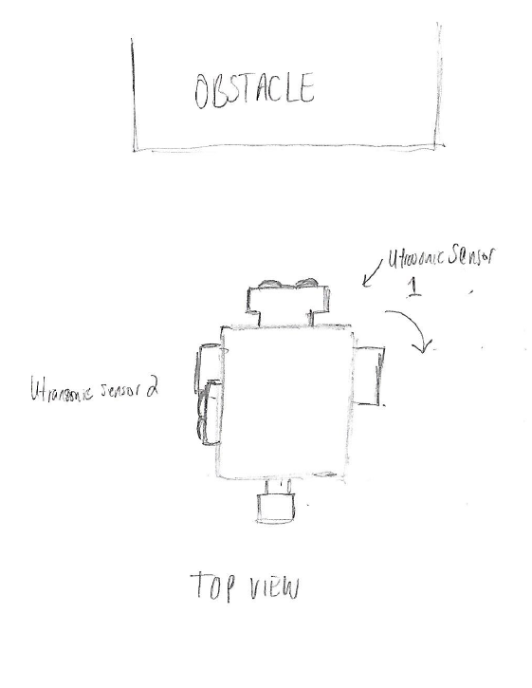
Navigating Mode
Front Sensor→ detect obstacles
Left and Right Drive Motor→ Navigate to destination by rotating wheels

Slide 4
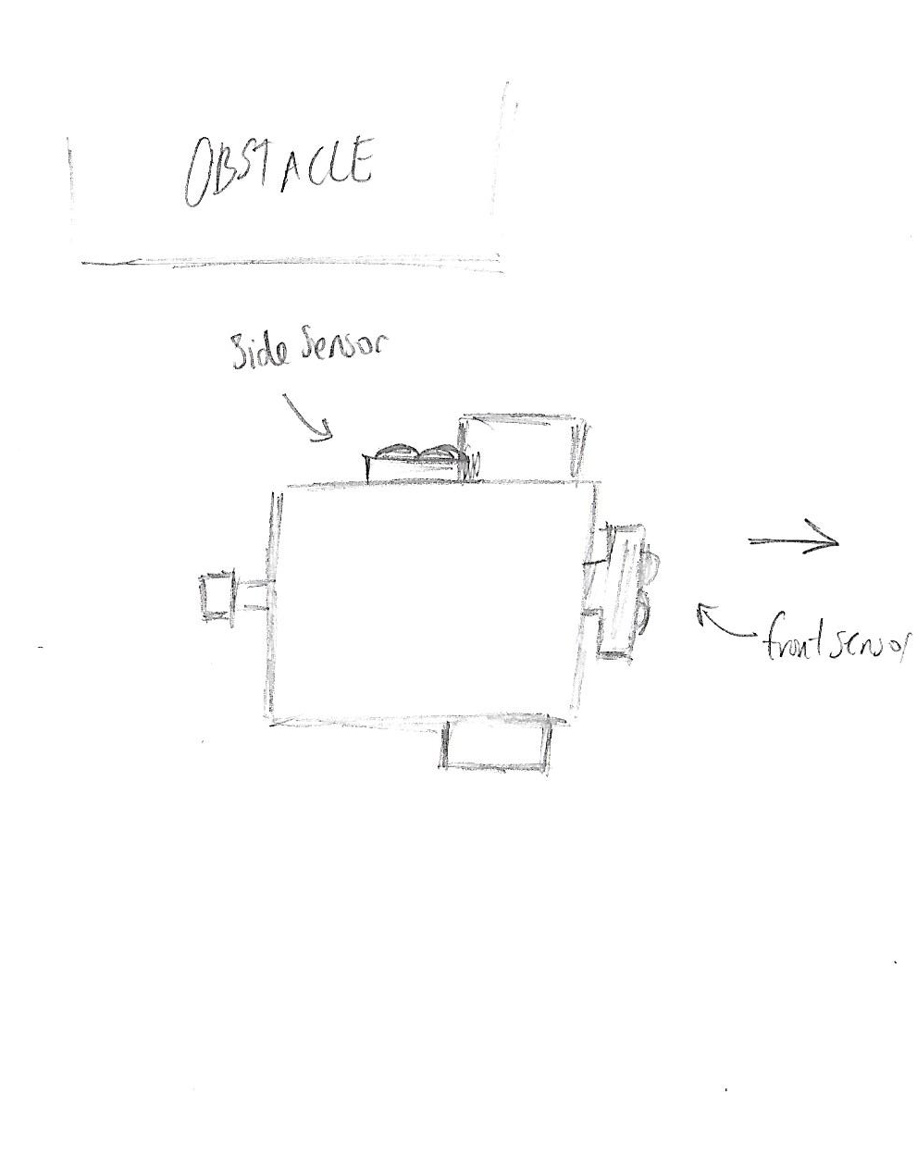
Obstacle Avoidance Mode
Front Sensor is used to obstacle
If detect obstacle rotate until front view is clear

Slide 5
Obstacle Avoidance cont’d
Drive forward slowly
Front Sensor is used to detect obstacles in front
Side Sensor is used to detect when the first obstacle is gone to return to navigation mode

Slide 6
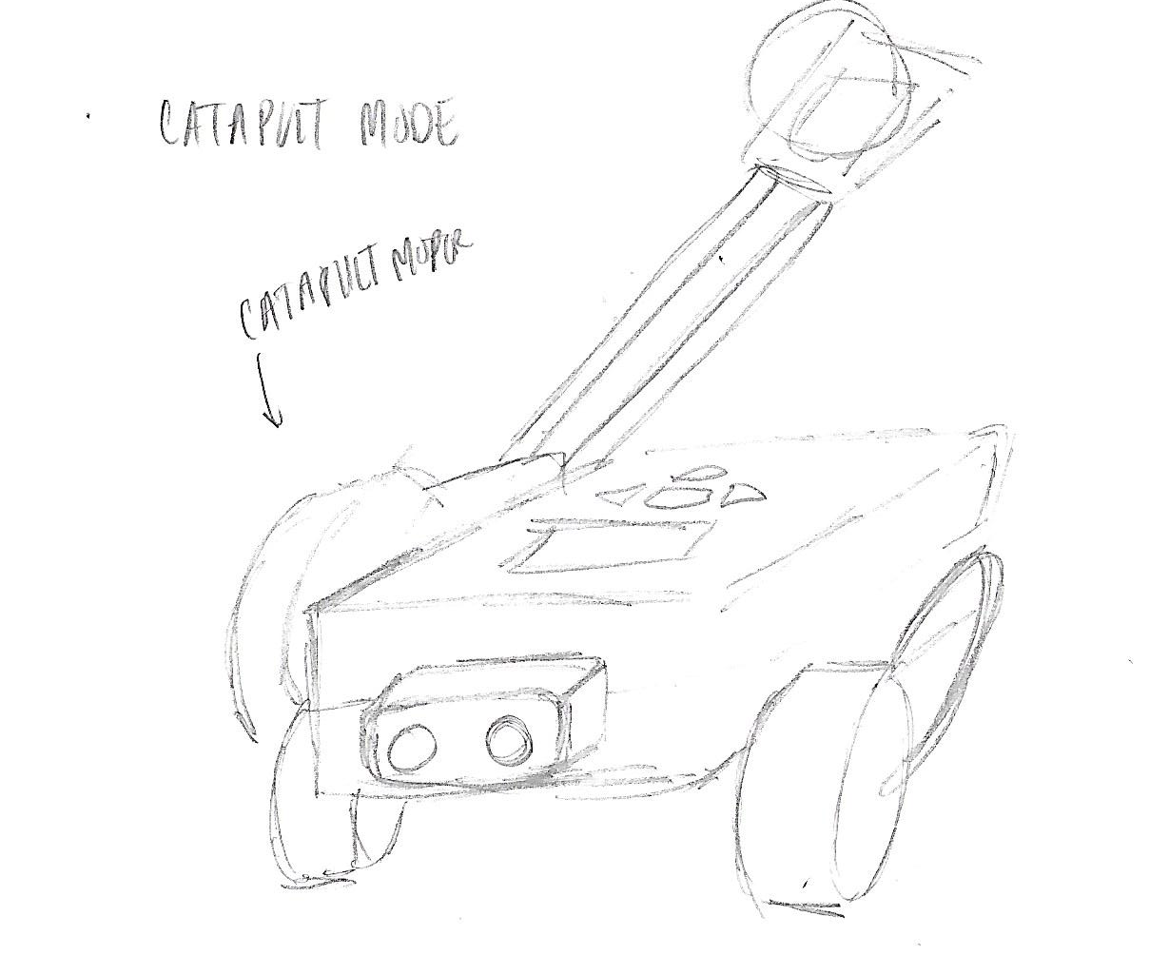
Catapult Mode
Components:
Catapult Motor→Shoot projectiles
Left and Right Wheel→Rotating

Slide 7
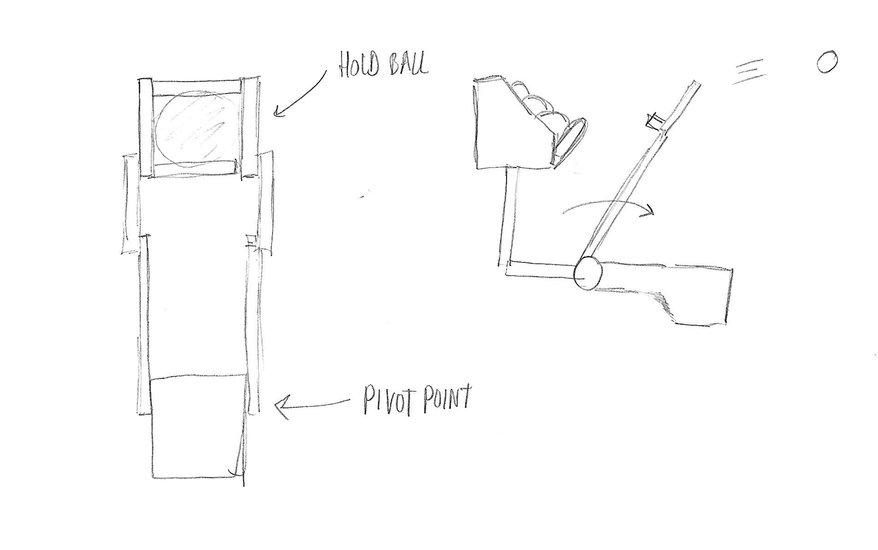

Slide 8
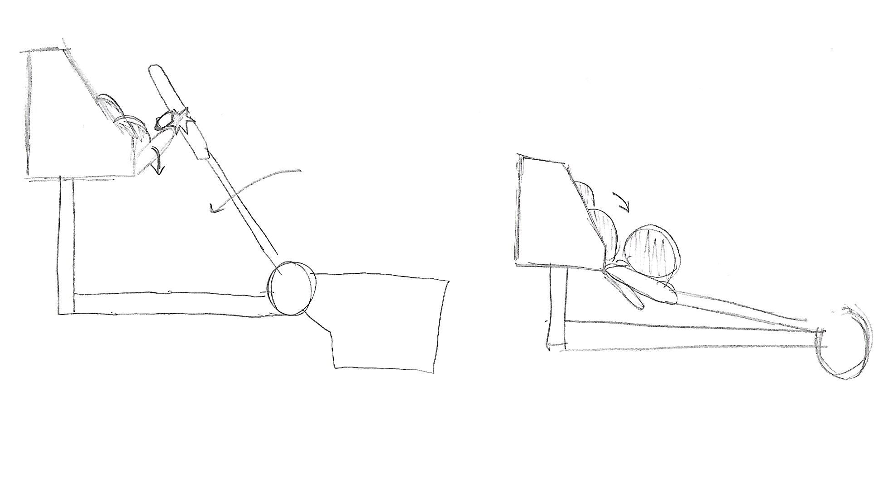
Switch to prevent balls in basket from falling

